Slide 1


Full Front-End Course
-VIVEKANAND OJHA

Slide 2

ALL I WANT YOUR TIME AND NO PRE-REQUISITES KNOWLEGDE.”

Slide 3
THE FRONT-END
1 WHAT YOU KNOW??
2 WHAT IT IS….

Slide 4
THE HTML
HTML (HyperText Markup Language) is the most basic building block of the Web. It defines the meaning and structure of web content. Other technologies besides HTML are generally used to describe a web page's appearance/presentation (CSS) or functionality/behavior (JavaScript).
"Hypertext" refers to links that connect web pages to one another, either within a single website or between websites. Links are a fundamental aspect of the Web. By uploading content to the Internet and linking it to pages created by other people, you become an active participant in the World Wide Web.

Slide 5
HEAD AND BODY
The <head> element is a container for metadata (data about data) and is placed between the <html> tag and the <body> tag.
HTML metadata is data about the HTML document. Metadata is not displayed.
]
Metadata typically define the document title, character set, styles, scripts, and other meta information.
The HTML <title> Element
The <title> element defines the title of the document. The title must be text-only, and it is shown in the browser's title bar or in the page's tab.
The <title> element is required in HTML documents!
The content of a page title is very important for search engine optimization (SEO)! The page title is used by search engine algorithms to decide the order when listing pages in search results.

Slide 6
Meta Tag
The <meta> tag defines metadata about an HTML document. Metadata is data (information) about data.
<meta> tags always go inside the <head> element, and are typically used to specify character set, page description, keywords, author of the document, and viewport settings.
Metadata will not be displayed on the page, but is machine parsable.
Metadata is used by browsers (how to display content or reload page), search engines (keywords), and other web services.
There is a method to let web designers take control over the viewport (the user's visible area of a web page), through the <meta> tag (See "Setting The Viewport" example below).

Slide 7
THE HTML ELEMENTS
HTML Elements
The HTML element is everything from the start tag to the end tag:
<tagname>Content goes here...</tagname>
Examples of some HTML elements:
<h1>My First Heading</h1>
<p>My first paragraph.</p>

Slide 8
How to Add HTML Headings To Your Web Page
In HTML, headings are written in the following elements:
<h1>
<h2>
<h3>
<h4>
<h5>
<h6>
As you might have guessed <h1> and <h2> should be used for the most important titles,
while the remaining tags should be used for sub-headings and less important text.
\

Slide 9
Examples
<!-- paired tag -->
<div> This is my first html class </div>
<!-- self closing tag -->
<input type="text">

Slide 10
Today’s Topic
What Are HTML Tags?
What are HTML Attributes?
HTML Editors
List of important tags
The anchor tag
The img(image tag)

Slide 11
What Are HTML Tags?
Tags are used to mark up the start of an HTML element and they are usually enclosed in angle brackets.
An example of a tag is: <h1>.
Most tags must be opened <h1> and closed </h1> in order to function.
NOTE THE WORD ‘usually’ : not all have enclosing tags

Slide 12
What are HTML Attributes?
Attributes contain additional pieces of information.
Attributes take the form of an opening tag and additional info is placed inside.
An example of an attribute is:
<img src="mydog.jpg" alt="A photo of my dog.">
In this instance, the image source (src) and the alt text (alt) are attributes of the <img> tag.
<input type=“text” >

Slide 13
HTML Editors
Now that we’ve gotten the basic theory out of the way. It’s time to learn how to build our first website.
First off, we must ensure that we have the right tools. Most important, we need an HTML editor.
Demo time with note pad

Slide 14
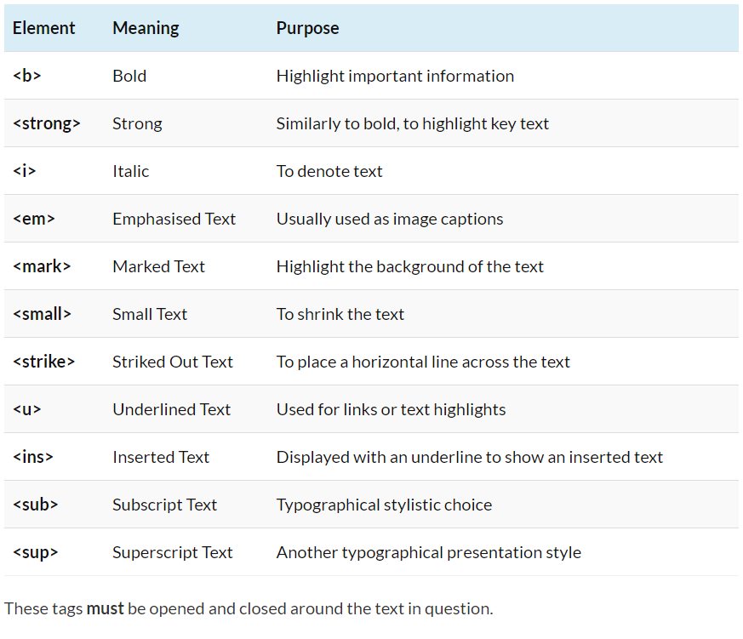

Slide 15
The Anchor Tag
The <a> (or anchor) opening tag is written in the format:
<a href="https://blogging.com/how-to-start-a-blog/">Your Link Text Here </a>
The first part of the attribute points to the page that will open once the link is clicked.
Meanwhile, the second part of the attribute contains the text which will be displayed to
a visitor in order to entice them to click on that link.
Attribute for new page : Target=“_blank”
Demo time;

Slide 16
The img tag
The <img> tag normally is written as follows:
<img src="yourimage.jpg" alt="Describe the image" height="X" width="X">
The image tag is used to insert image in wep page;
Demo time;

Slide 17
HTML FORM
<form>: The Form is HTML element which is required to GET the documents and information in different sections of html forms so that the data is more specific.
TAGS IN HTML FORMS
1- input – self closing tag
2- select – paired tag
3- label – paired tag
4- textarea - paired tag
5- button – paired tag
Demo;

Slide 18
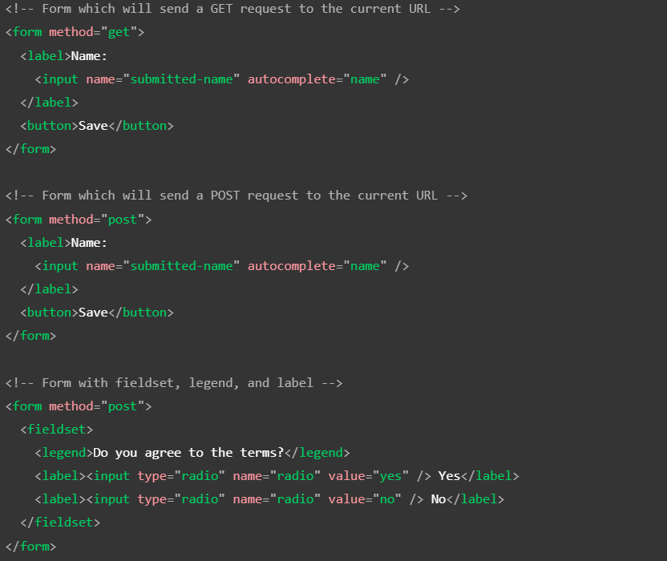

Slide 19
TODAY’S TOPIC(4 JUNE)
WHAT IS HTML FORM?(recap)
FORM SYNTAX
FORM ELEMENTS
DEMO
HTML List -- -
CLASS AND IDS
LABEL AND DATALIST

Slide 20
What is HTML <form>?
<form> is an HTML element to collect input data containing interactive controls. It provides facilities to input text, number, values, email, password, and control fields such as checkboxes, radio buttons, submit buttons, etc., or in other words, form is a container that contains input elements like text, email, number, radio buttons, checkboxes, submit buttons, etc.

Slide 21
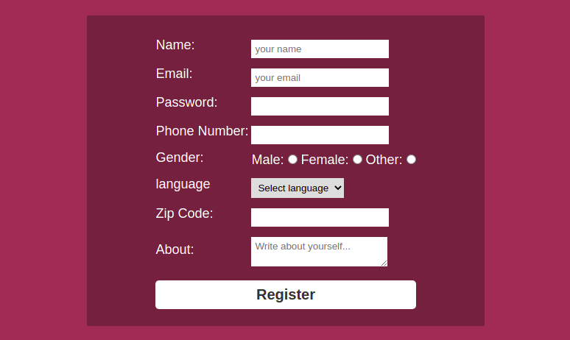

Slide 22
FORM Syntax
Syntax:
<form> <!--form elements--> </form>

Slide 23
FORM ELEMENTS
<label>: It defines label for <form> elements.
<input>: It is used to get input data from the form in various types such as text, password, email, etc by changing its type.
<button>: It defines a clickable button to control other elements or execute a functionality.
<select>: It is used to create a drop-down list.
<textarea>: It is used to get input long text content.
<fieldset>: It is used to draw a box around other form elements and group the related data.
<legend>: It defines a caption for fieldset elements.
<datalist>: It is used to specify pre-defined list options for input controls.
<output>: It displays the output of performed calculations.
<option>: It is used to define options in a drop-down list.
<optgroup>: It is used to define group-related options in a drop-down list.

Slide 24
HTML List
Listing in html is done in two ways
Ordered List – the list of items are arranged in some specified order. And the tag used for ordered list is <ol></ol> tag
syntax <ol type=“1”> list tags li </ol>
2. Unordered list- the list of items are arranged in NO specified order. And the tag used for unordered list is ul tag
syntax <ul type=“disc”> list tags li </ul>
DEMO ;

Slide 25
CLASS AND IDS
The HTML class attribute is used to specify a class for an HTML element.
Multiple HTML elements can share the same class.
The id attribute specifies a unique id for an HTML element. The value of the id attribute must be unique within the HTML document.
The id attribute is used to point to a specific style declaration in a style sheet. It is also used by JavaScript to access and manipulate the element with the specific id.

Slide 26
LABELS
The <label> HTML element represents a caption for an item in a user interface
Syntax-
<label for="cheese">Do you like cheese?</label>
<input type="checkbox" name="cheese" id="cheese"></div>

Slide 27
DATALIST
A datalist with pre-defined options (connected to an <input> element):
<label for="browser">Choose your browser from the list:</label> <input list="browsers" name="browser" id="browser"> <datalist id="browsers"> <option value="Edge"> <option value="Firefox"> <option value="Chrome"> <option value="Opera"> <option value="Safari"> </datalist>

